Slide 1
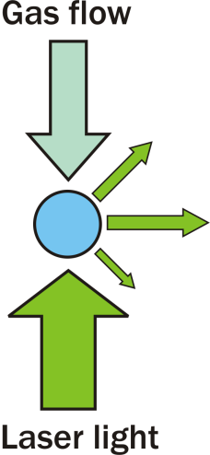
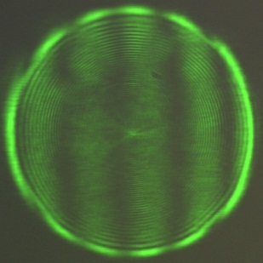
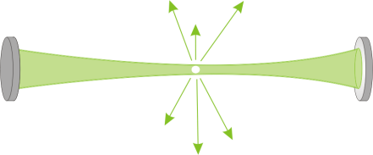
Techniques for probing fundamental aerosol properties
Phase function, σ_{geom}
Cavity ring-down spectroscopy, σ_{ext}
Radiation pressure, Q_{pr}
Bernard Mason
University of Bristol
Mon 21st April 2014
Notes:
Explanation of ring down problems

Slide 2
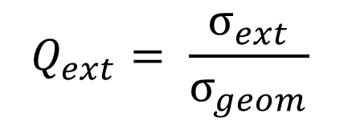
Optical extinction of aerosol particles
In atmosphere particulate extinction is dependent on many factors
Size and refractive index
Phase (separations, inclusions)
Morphology
$$Q_{ext}= \frac{σ_{ext}}{σ_{geom}}$$
Q_{ext} – Extinction efficiency
Experimental data of spherical and non-absorbing so scattering and extinction are analogouss

Slide 3
Project aims
To develop and characterise the potential of experimental systems for measuring fundamental optical (and thermodynamic) properties
Use ensemble cavity ring down spectroscopy for measurement of aerosol particles extinction cross-sections and refractive index retrieval – where are the limitations?
Develop a single particle cavity ring down spectrometer for measurement of aerosol extinction cross-sections.

Slide 4
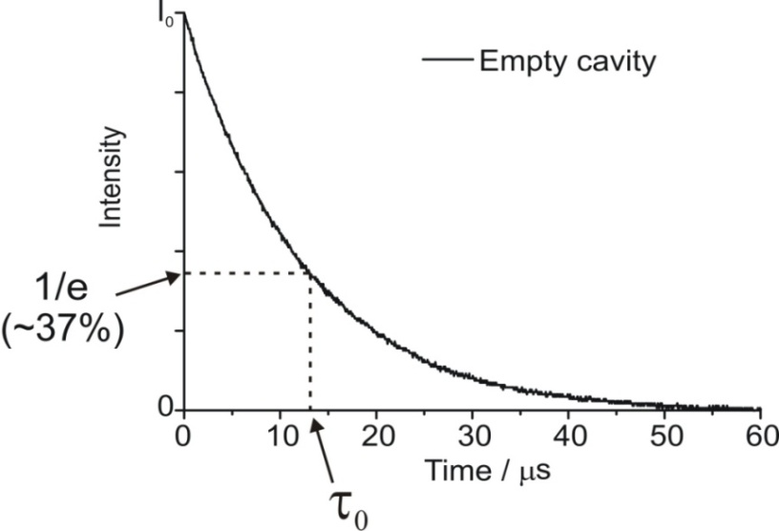
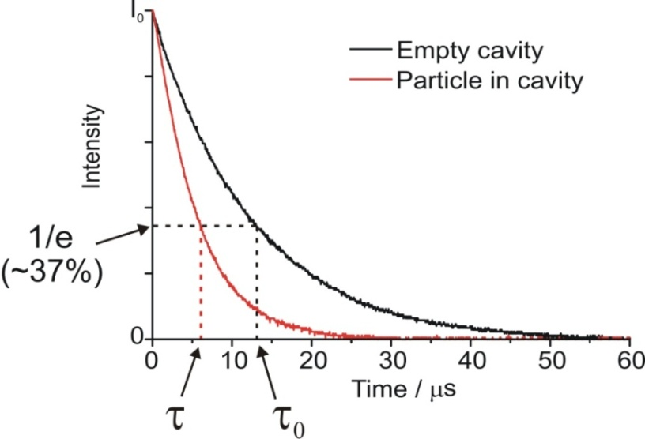
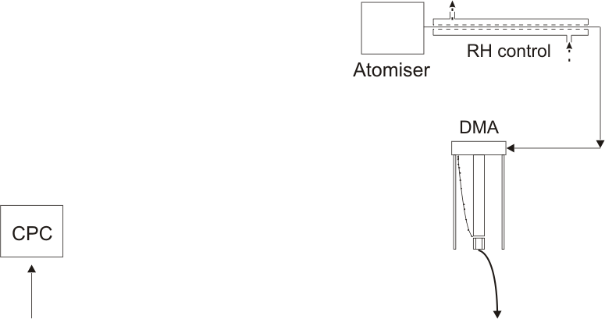
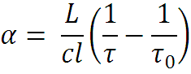
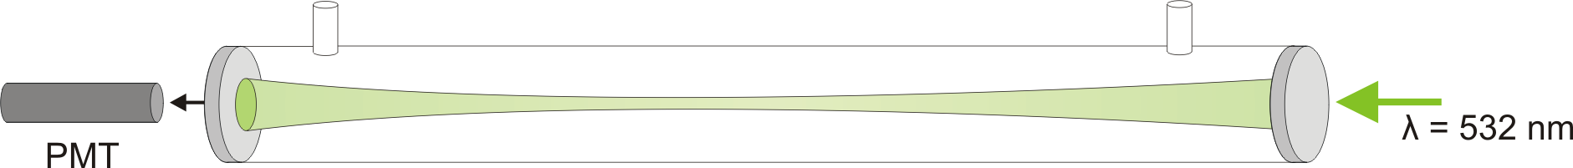
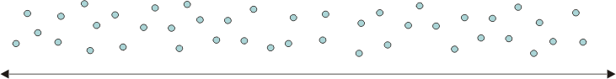
Ensemble cavity ring-down system
Filled cavity
l = L
L

Slide 5
Sodium nitrate aerosol
Interested in determining how well we can retrieve the RH dependent refractive index of a reasonably well characterised system
Tang, I. & Munkelwitz, J. Geophys. Res (1994)
Discrepancies in efflorescence relative humidity: between 47 % and 30 – 0.05 %
Lee, M.-J. et al. Atmos. Chem. Phys. Discuss (2011)
Compare the refractive indices with those determined using optical tweezers
Mason, B. J. et al. J. Phys. Chem (2012).

Slide 6
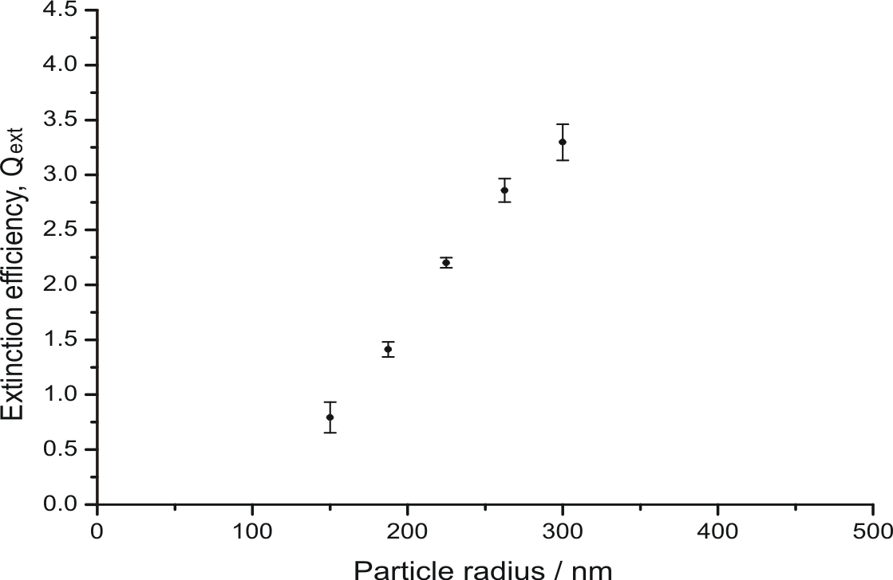
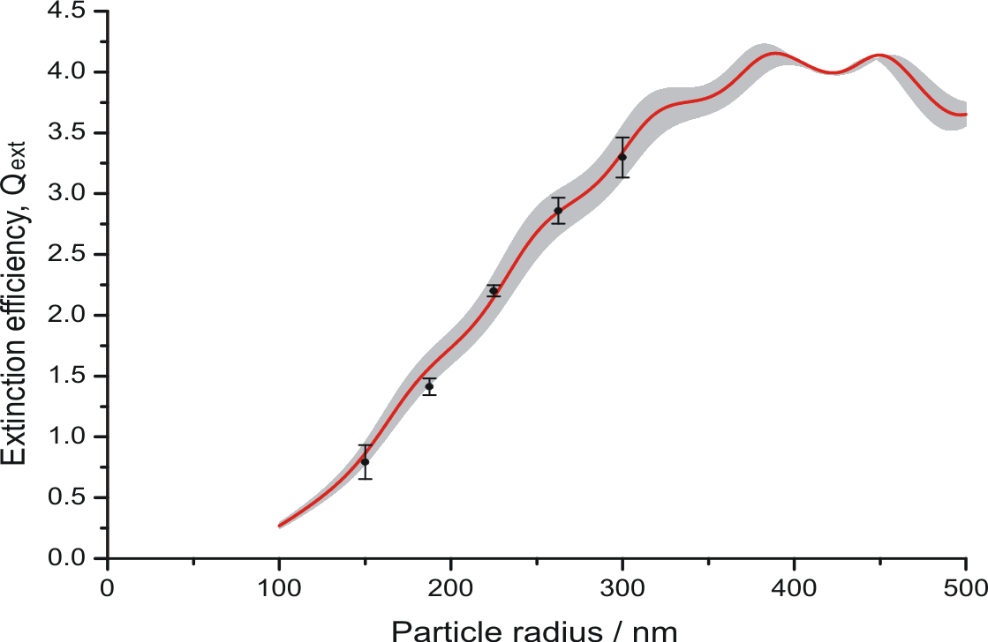
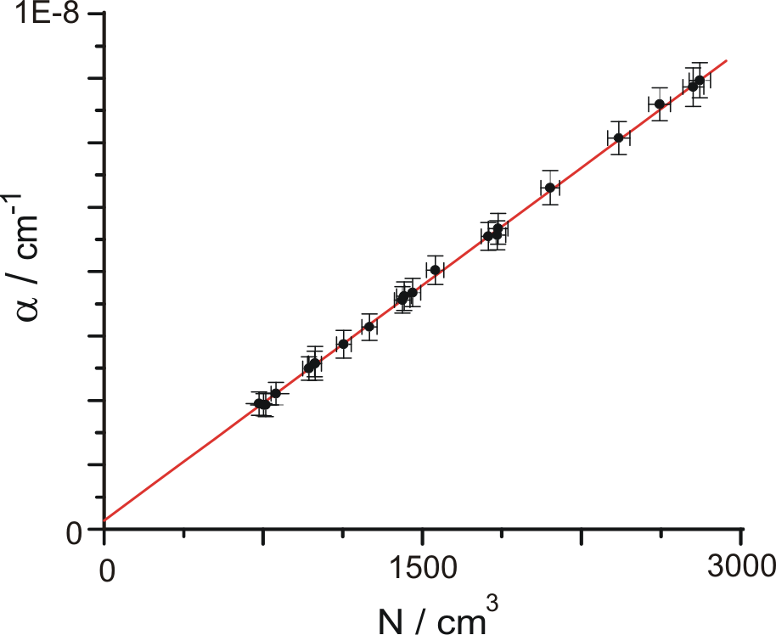
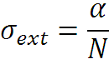
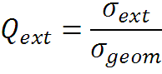
Ensemble CRDS – RI retrieval
NaNO₃ – 40 % RH
RI = 1.423 – Best fit Mie simulation
Shaded +/- 0.02
Miles, R. E. H., et al. Aerosol Sci. Technol. (2011)

Slide 7
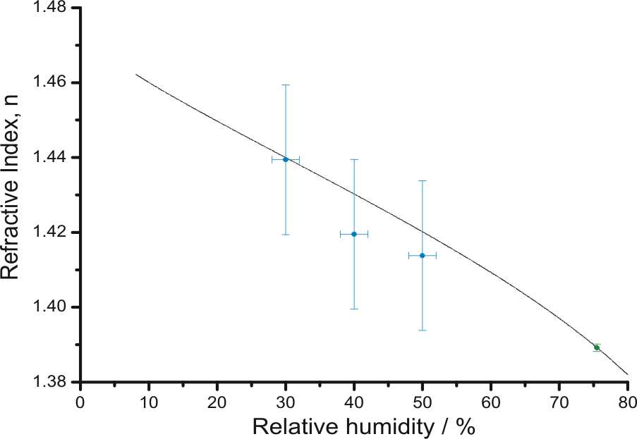
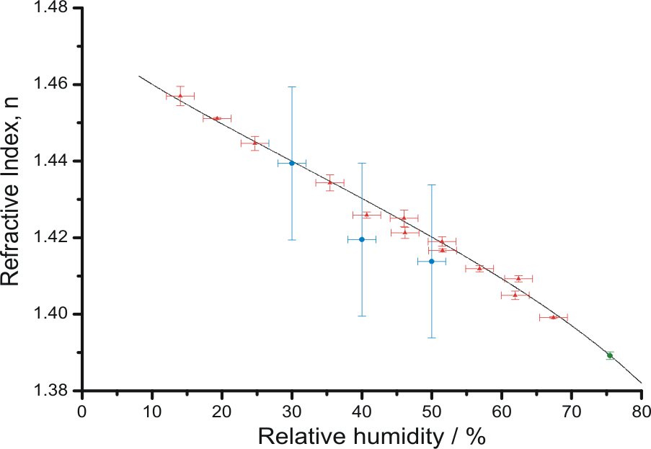
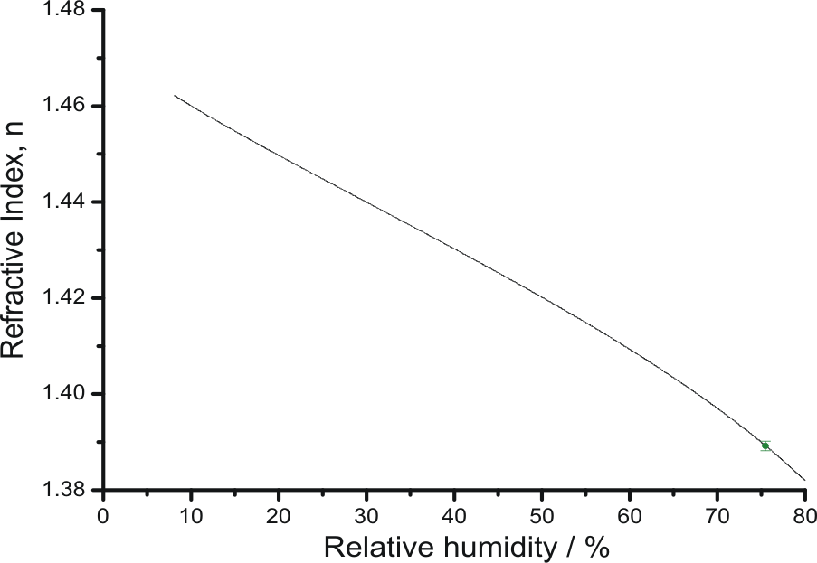
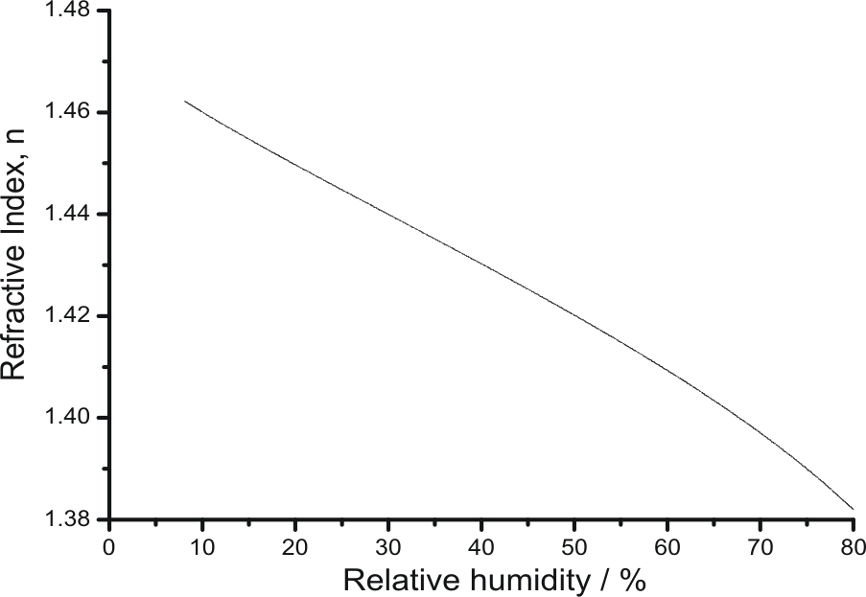
Ensemble vs single particle
Fit to electrodynamic balance – coarse mode [1]
Aqueous NaNO₃
Refractometer – bulk solution
Ensemble A-CRDS – accumulation mode [2]
Optical tweezers – coarse mode [2]
No efflorescence observed in OT measurements

Slide 8
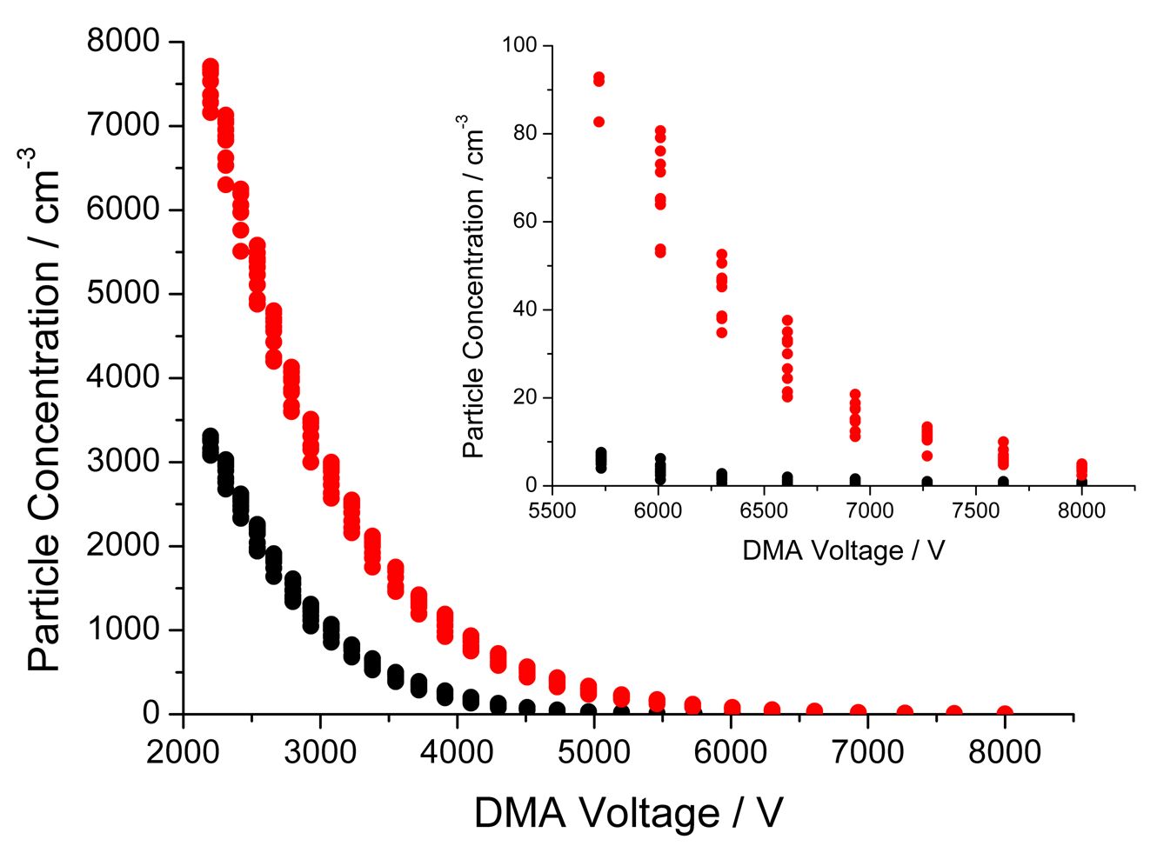
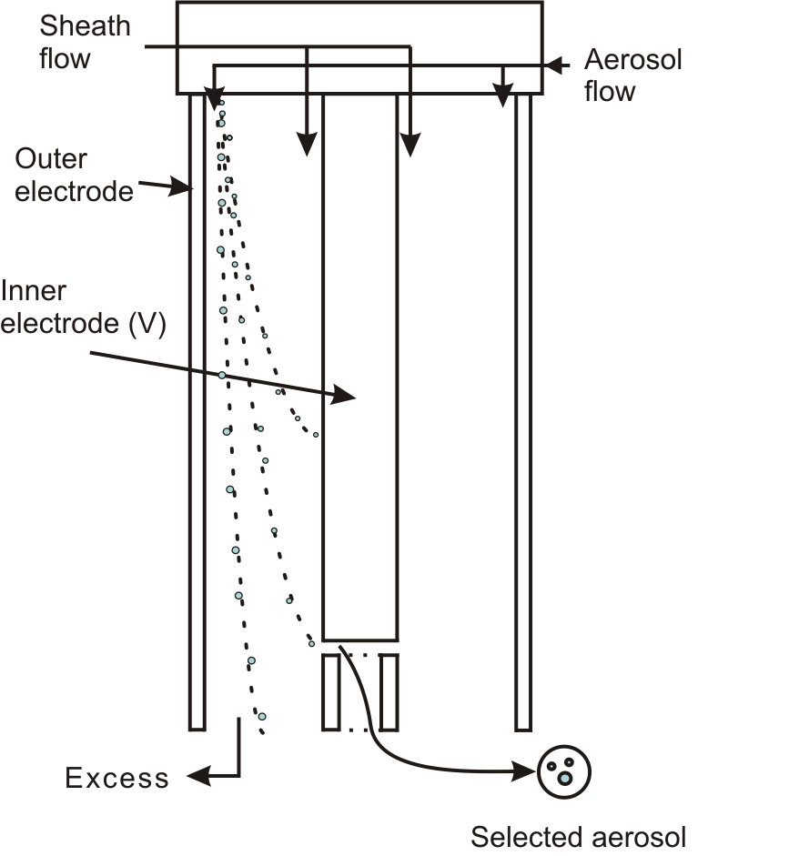
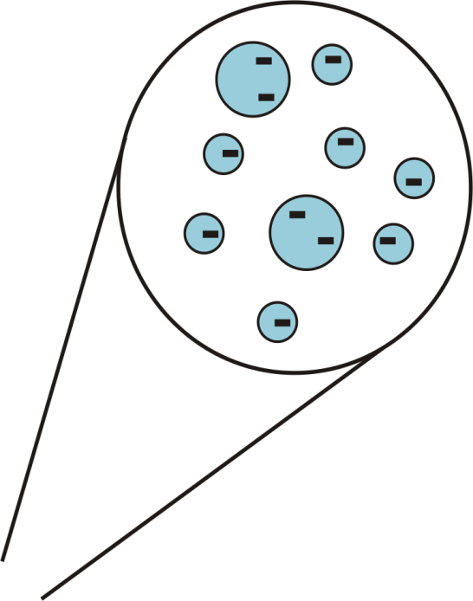
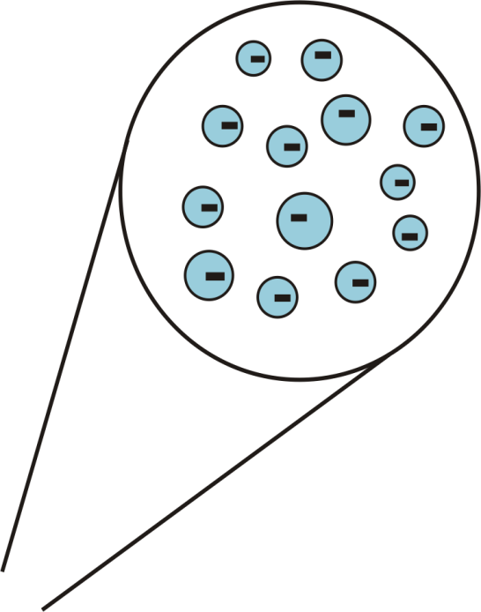
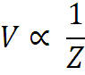
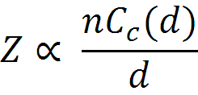
Differential Mobility Analyser - DMA
DMA
The size distribution is dependent on:
DMA transfer function
Charge distribution imposed by the neutraliser
Pre-DMA size distribution

Slide 9
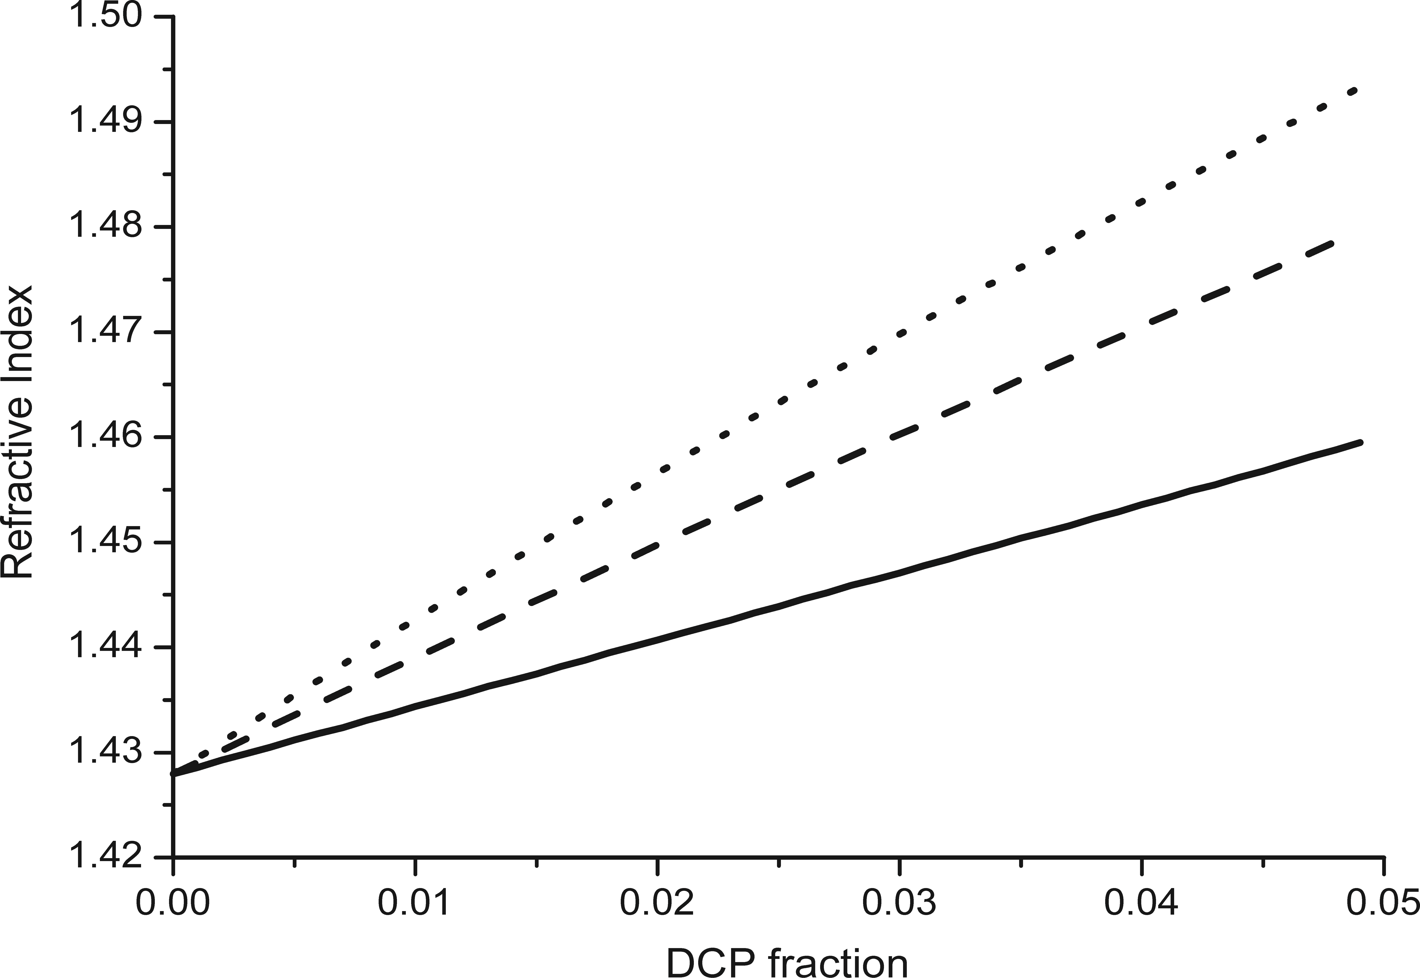
Effect of concentration on DCP fraction
150 nm dried to 55 % relative humidity. Liquid droplets.
Sodium chloride aerosol
150 nm
(C)
(C) – 3.9 %
Varying the mixing gives a range of number densities.
(D) – 5.1 %
(D)
225 nm
(B)
(B) – 2.2 %
Varying the concentration of solution gives different extinction cross-sections
300 nm
(A)
(A) – 1.6 %
What about the DMA size distribution?

Slide 10
DMA – transfer function
DMA selection voltage = 2007 V
Transfer function amplitudes are arbitrary
n = 1
Assuming an ideal transfer function; no broadening
Notes:
Simulation of DMA transfer function in mobility and diameter space

Slide 11
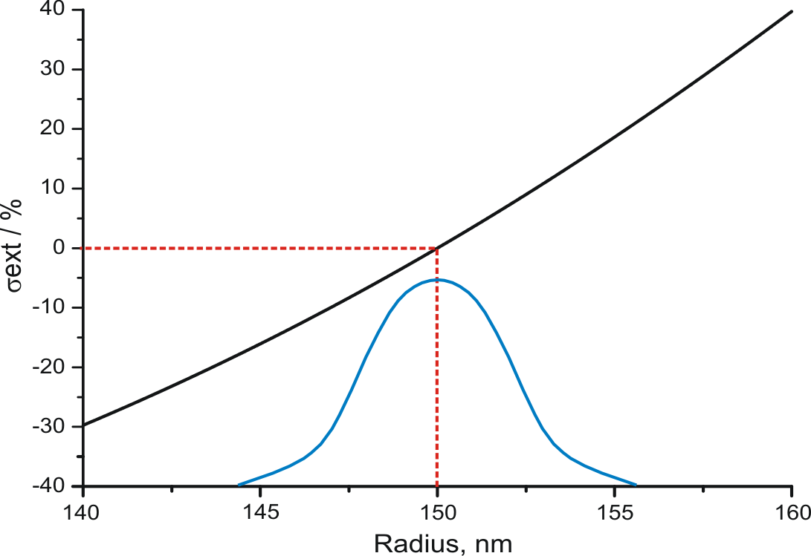
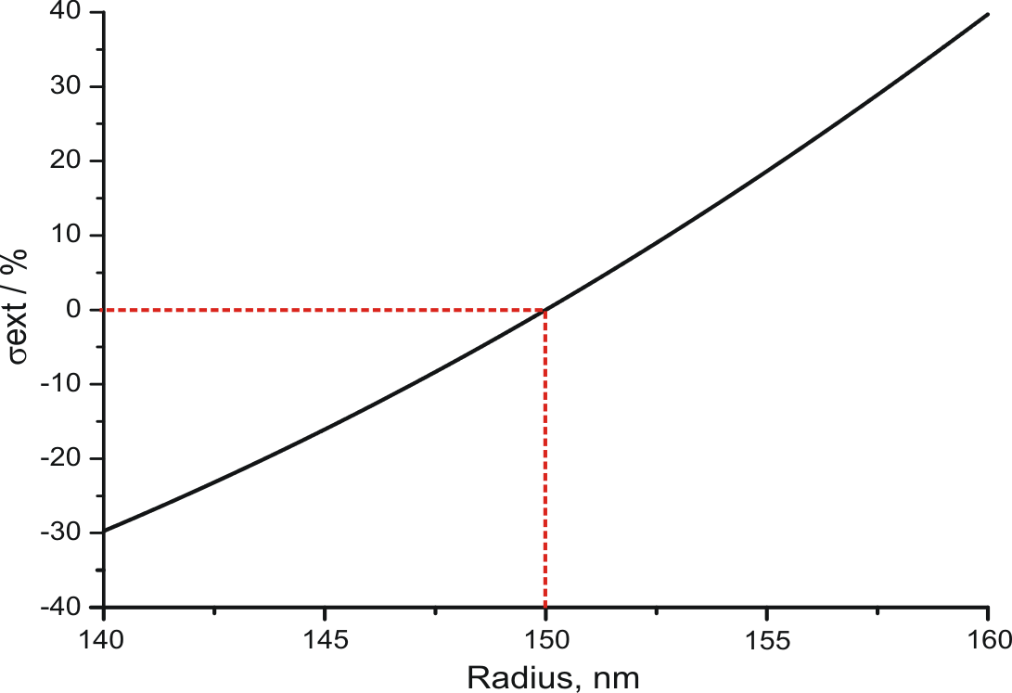
Ensemble A-CRDS uncertainty in radius
Large variation in extinction cross-section with particle size.
150 nm
How does the transfer function affect the size distribution?
ext
How does the nebulised size distributed affect the size distribution?

Slide 12
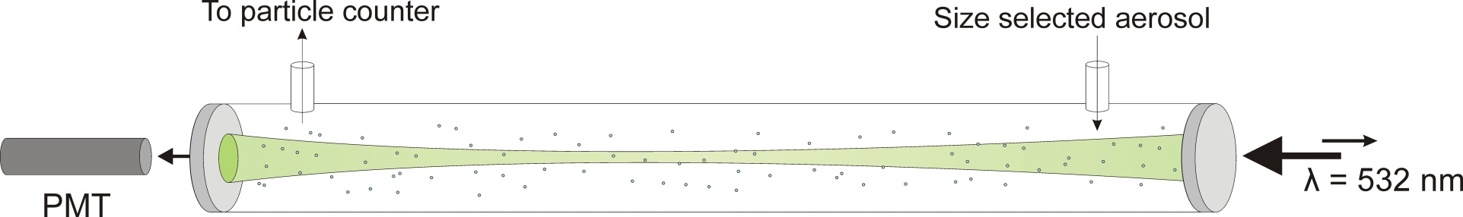
Ensemble cavity ring-down spectroscopy
Problems:
Uncertainty in the size distribution exiting our DMA
Uncertainty in the optical cross-section distribution
Uncertainty in length of the cavity occupied by aerosol particles
Sensitive measurement of particle extinction
Limited by knowledge of size distribution

Slide 13
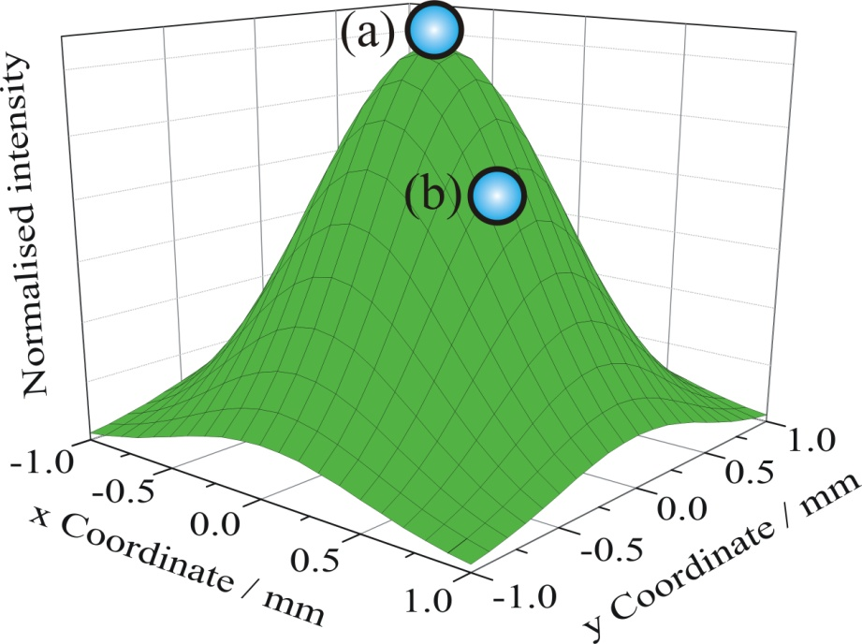
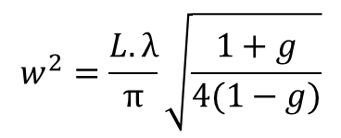
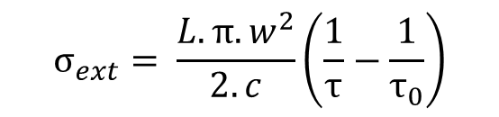
Single particle cavity ring-down system
$$σ_{ext}= \frac{L.π.w^{2}}{2.c}\left(\frac{1}{τ}−\frac{1}{τ_{0}}\right)$$
Removed uncertainties from ensemble technique
w – ring down event beam waist
Uncertainties:
Beam waist
Particle position
$$w_{}^{2}=\frac{L.λ}{π}\sqrt{\frac{1+g}{4(1−g)}}$$
It is important that we keep our particle in a fixed position!
1. Butler, T. J. a, Miller, J. L., & Orr-Ewing, A. J. (2007). The Journal of chemical physics, 126(17), 174302

Slide 14
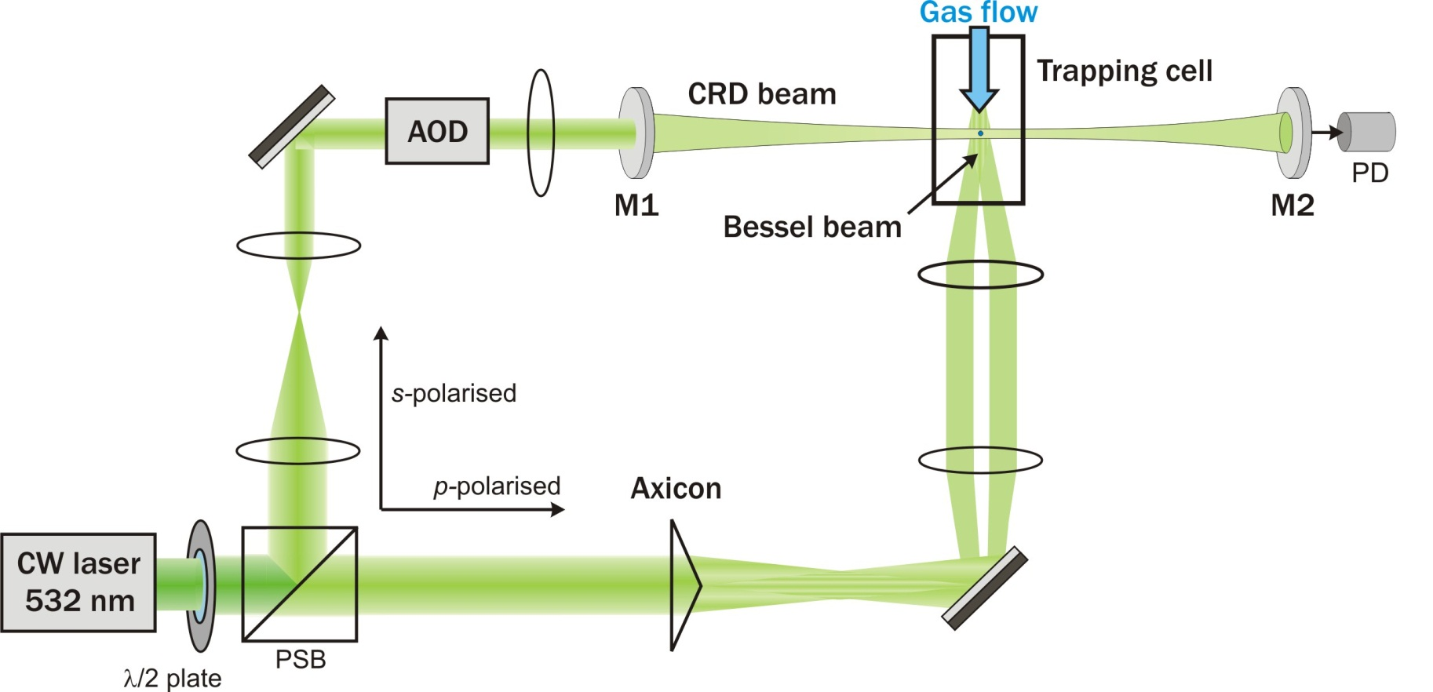
Cavity ring-down-Bessel beam system
In addition to the extinction cross-section we can probe:
1. The particle radius
2. The radiation pressure efficiency

Slide 15
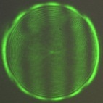
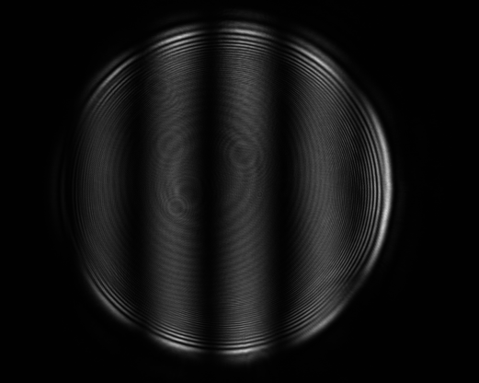
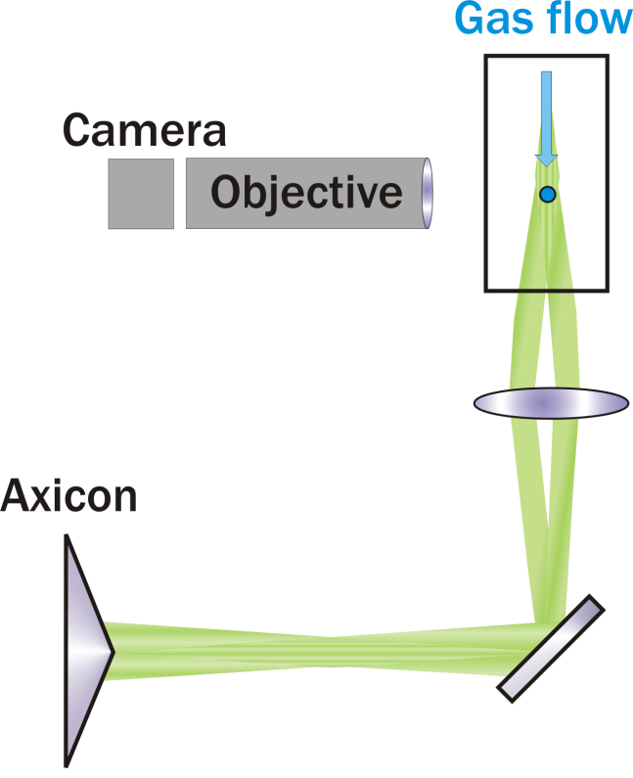
Cavity ring-down-Bessel beam system
Phase function
Elastically scattered light
Particle radius = 1314 nm

Slide 16

Laser feedback – radiation pressure
Radiation pressure efficiency (Q_{pr})
Efficiency of momentum transfer by the incident beam due to angular dependence of scattering
Laser power required to keep particle at fixed height changes with size and refractive index
Can be compared qualitatively to laser power simulations
Notes:
As we’ve already shown light scattering has an angular dependence that is in turn dependent on the size and refractive index of particle. As such the momentum imparted by the incident beam changes as the particle changes in size meaning that the power required to keep it in a fixed position also changes. We therefore have to respond to the particles changing position by changing the laser power.

Slide 17
Cavity ring-down-Bessel beam system
Three measurements of particle scattering
Two advantages over conventional optical tweezers and electrodynamic balances
The ability to trap and probe smaller particles
The ability to get effective optical properties of the whole particle
First look at simple systems and compare with simulations
1,2,6-Hexanetriol - fixed refractive index
NaCl/H₂O
Ammonium sulphate/H₂0
changing refractive index with relative humidity
Notes:
Hexanetriol has a relatively low vapour pressure and will change size in a predictable manner with time.
NaCl is very well characterised, it should be possible to guess how the RI varies with size.
Important that we’re looking for agreement.

Slide 18
1,2,6 - Hexanetriol
Dry conditions - < 5 % RH RI = 1.480
Radius from phase function

Slide 19
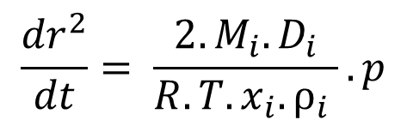
Hexanetriol – Vapour pressure
$$\frac{{dr}^{2}}{dt}= \frac{2.M_{i}.D_{i}}{R.T.x_{i}.ρ_{i} }.p$$
p = (5.58 ± 1.29)*10⁻⁴ Pa
p(EDB) = 2.27*10⁻⁴ Pa
p(OT) = 1.15*10⁻⁴ Pa

Slide 20
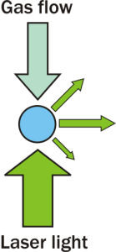
Hexanetriol – Vapour pressure
Indication of good estimation of refractive index
Qualitative only, but useful as a method of confirming radius retrieved from phase function

Slide 21
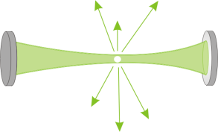
Hexanetriol – Particle extinction
1
4
1. Particle outside ring down events, τ₀ recorded
τ₀ ± s
Decreasing particle size
2. Particle brought into centre of ring down events, τ recorded
3
3. Particle evaporates
2
4. Particle falls out, τ₀ recorded
τ ± s

Slide 22
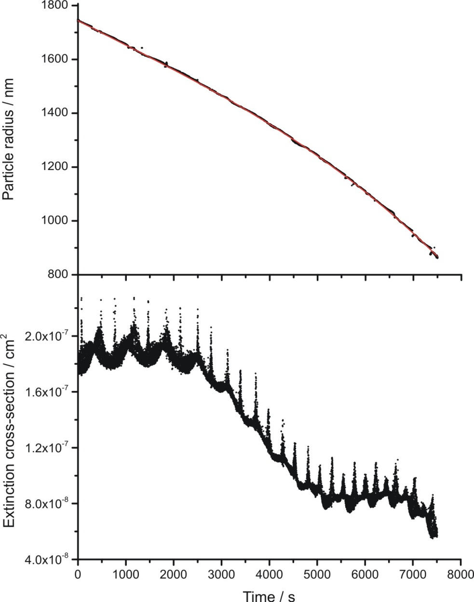
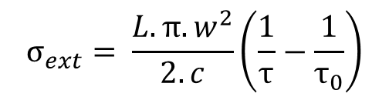
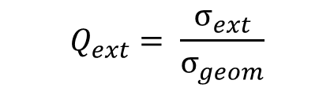
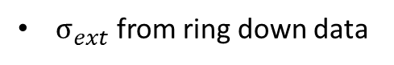
Hexanetriol – Particle extinction
Radius from phase function
Assuming a refractive index, n = 1.476
Particle radius / nm
$$σ_{ext}= \frac{L.π.w^{2}}{2.c}\left(\frac{1}{τ}−\frac{1}{τ_{0}}\right)$$
$σ_{ext}$ from ring down data
Extinction cross-section / cm⁻¹
$$Q_{ext}= \frac{σ_{ext}}{σ_{geom}}$$
Time / s

Slide 23
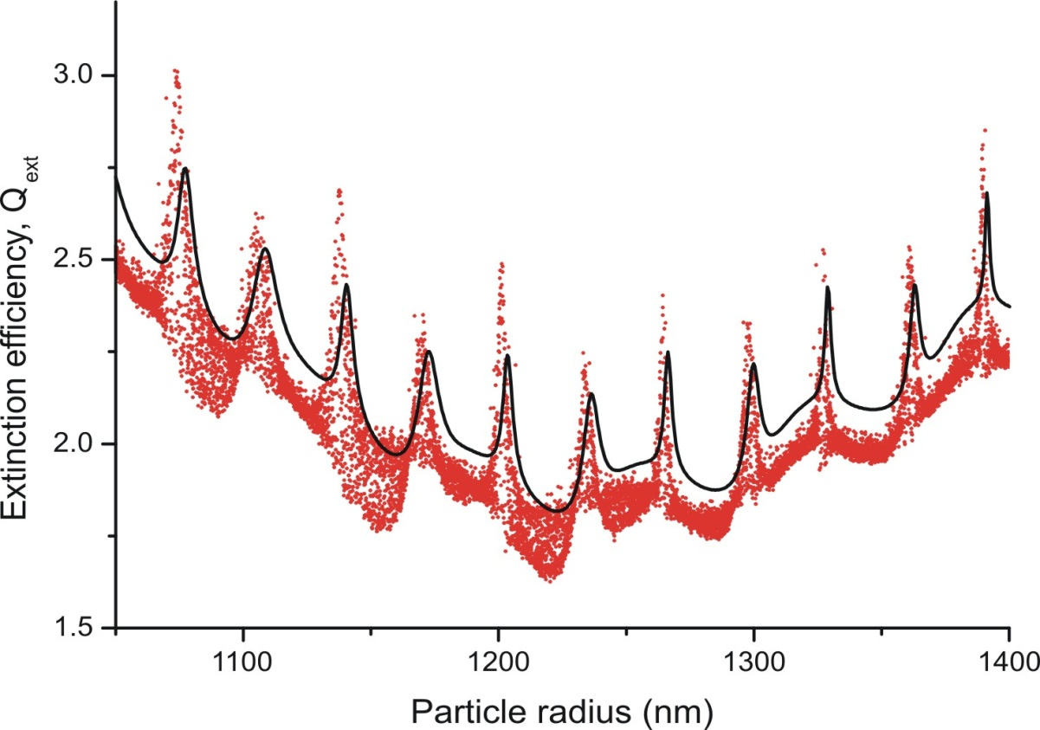
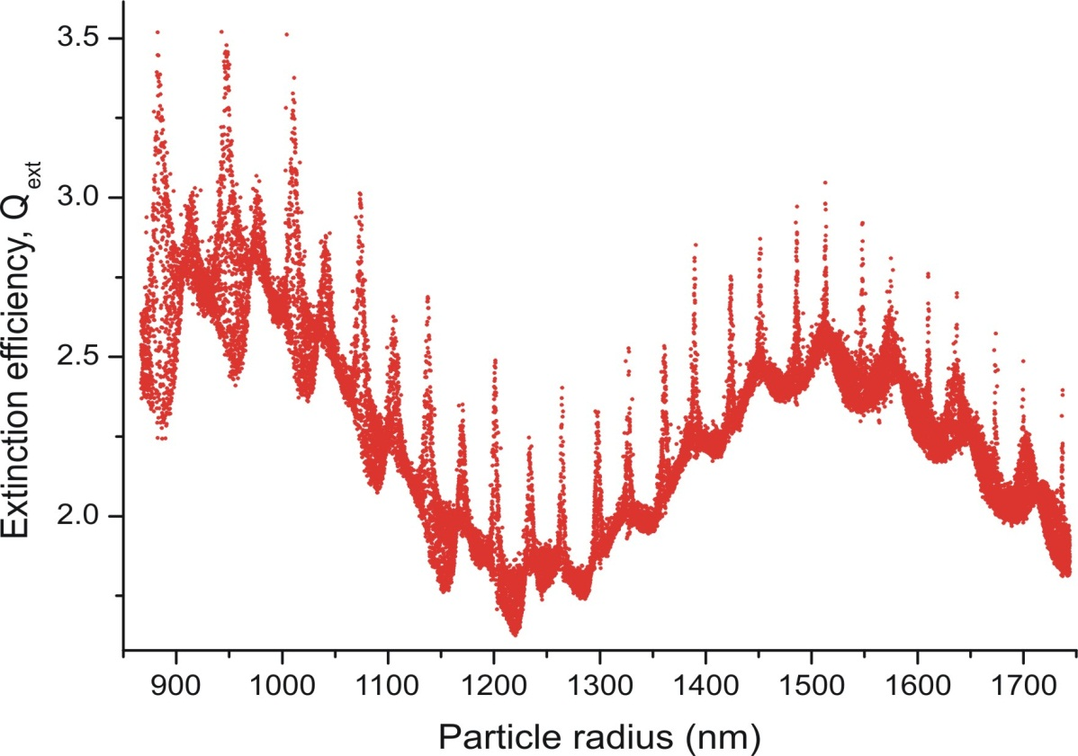
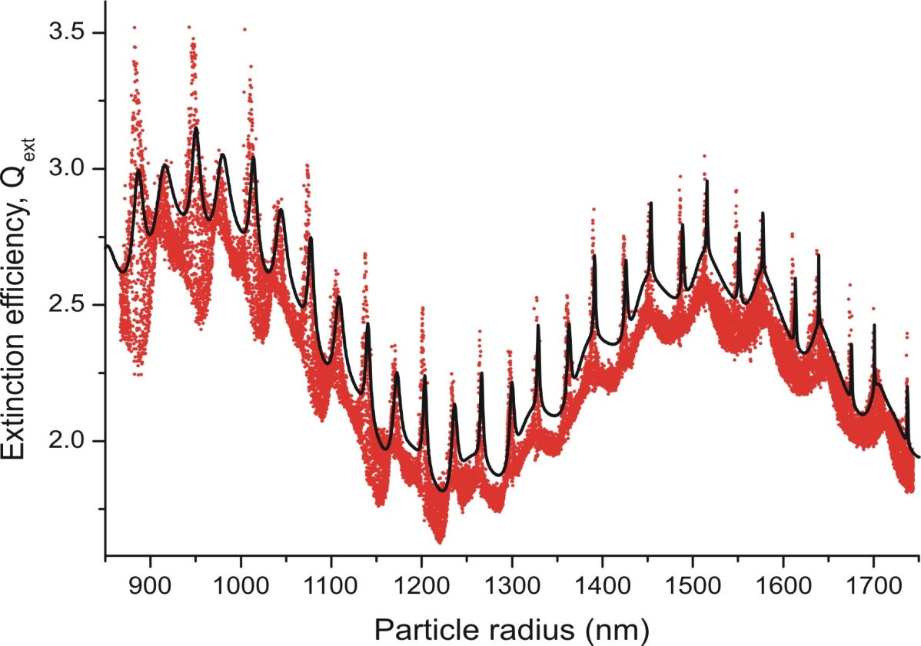
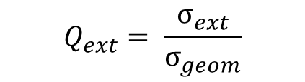
Hexanetriol - Extinction efficiency
$$Q_{ext}= \frac{σ_{ext}}{σ_{geom}}$$
Experimental data
Beam waist, w₀ = 270.9 μm
Simulated data
Refractive index = 1.476
Why do we have an envelope in the extinction data?
Why do we have an offset between experimental and sims?

Slide 24
Extinction envelope
The vertical (y) motion of the particle is monitored and cannot account for the envelope
To explain the extinction envelope we must think of effect of the longitudinal, z, position of the particle on the amount of light scattered
z

Slide 25
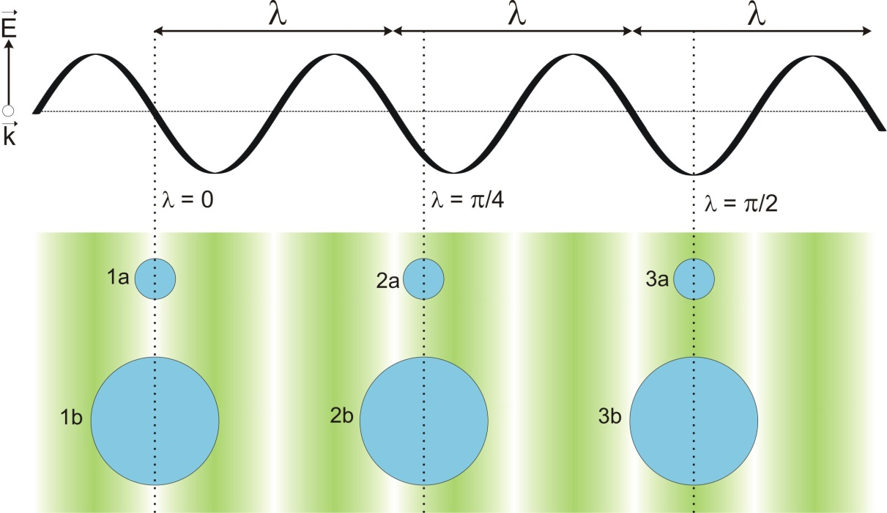
Extinction envelope
Consider a theoretical standing wave where the electric field only varies in the direction of the wave vector (z)
A particle introducing into this standing wave will cause light to be scattered and/or absorbed
The size and phase position of a particle within in the standing wave determines its overlap
How can this overlap be described?

Slide 26
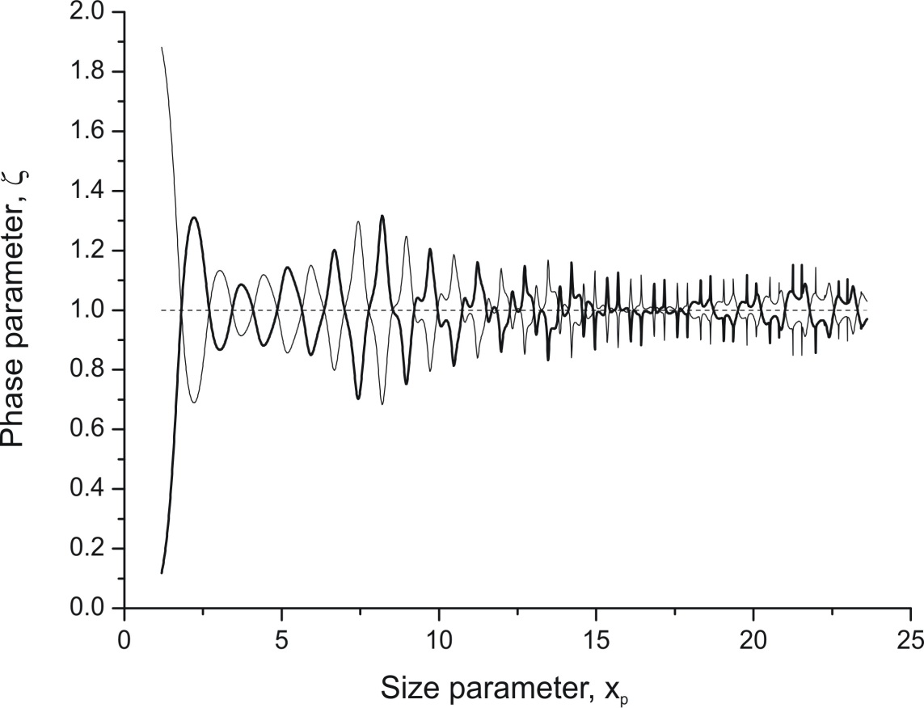
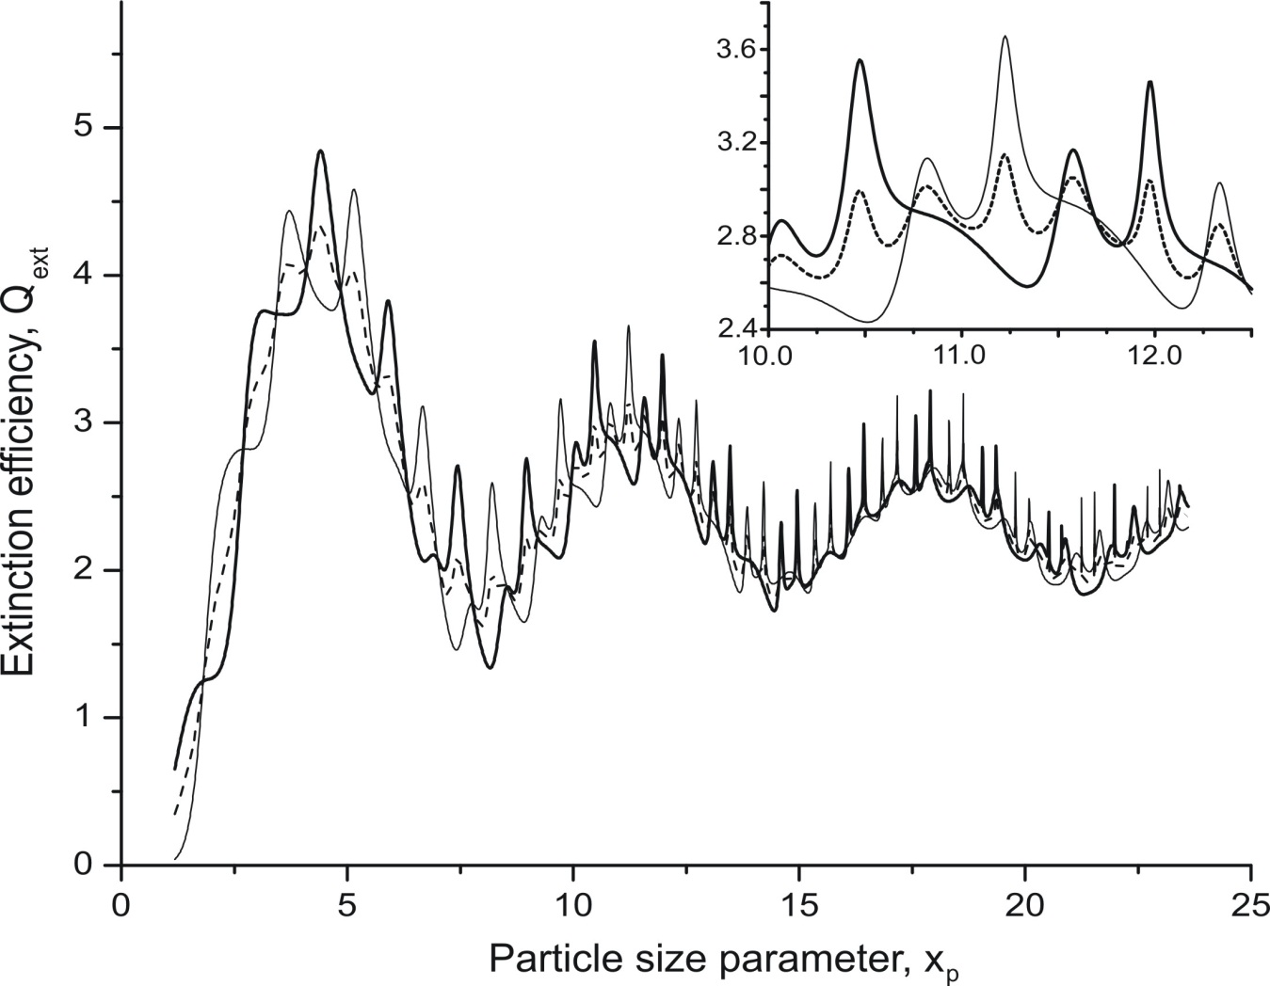


The phase parameter
The phase parameter is used to describe this positional dependence
Node – thick line
Antinode – thin line
Plane wave – dashed line
$$σ_{ext}=\frac{σ}{ζ(z)}$$
$$Q_{ext}=\frac{σ}{ζ(z)σ_{geom}}$$
Miller, J. L. & Orr-Ewing, A. J. J. Chem. Phys. (2007)

Slide 27


Extinction efficiency
$$Q_{ext}=\frac{σ}{ζ(z)σ_{geom}}$$
Experimental data
Beam waist, w₀ = 270.9 μm
Simulated data
Refractive index = 1.476
Why do we have an offset between experimental and sims?
Deviation of beam waist from ideal
Particle not central in ring down events
If the beam waist is not ideal can we fit it?

Slide 28

Hexanetriol - Extinction efficiency
Experimental data
Simulated data sets
RI = 1.476
Beam waist floated
The quality of fit is determined by the number of points that fall within the envelope
Our agreement after fitting the beam waist is much better, however no consideration of how the RI used in the phase function fitting may differ from the true RI

Slide 29



Hexanetriol – RI determination
Simulated data
RI and beam waist floated
The radius, r₁, from the phase function must be modified to account for each RI used in the fitting n₂
$$n1r1=n2r2$$
Notes:
As the particle becomes smaller it becomes harder to keep it in the centre of the ring down events leading to an increase in the spread of ring down times

Slide 30


Hexanetriol - Extinction efficiency
Fitted RI = 1.4775 ± 0.0004!
Beam waist = 278.85
~ 33.5 % of points outside envelope
B.J. Mason, J.S. et al, J. Phys. Chem. A. in press

Slide 31

Hexanetriol – Refractive index
Three more Hexanetriol particles
Best RI = 1.47824 ± 0.00072
Very sensitive measurement of extinction cross-section
What about a system where the refractive index varies?

Slide 32

Phase function fitting with RI(RH)
It is computationally expensive to simulate and fit a large phase function set across a range of radii and refractive indices
Initially we must assume a dependence of refractive index on radius
We must either use an RH probe to determine the composition of the particle at a particular point in time or assume that that particle is ejected from the trap at its efflorescence relative humidity

Slide 33

NaCl/water - radius
1st assumption: conc/RI at efflorescence RH is known
RH ~ 70 %
Size of particle at efflorescence determined
ERH ~ 45 %
2nd assumption: variation of conc/RI with radius known
Tang, I. & Munkelwitz, J. Geophys. Res (1994)
Notes:
At the end I can explain why this isn’t physical.

Slide 34




NaCl – refractive index
Refractive index dependence 1: 25.88% of points outside envelope
Refractive index dependence 2: 23.53% of points outside envelope
Refractive index dependence 3: 22.98% of points outside envelope
Notes:
Either RH is higher than we expect or the RI is lower than we’d expect.

Slide 35
Conclusions
We can use single particle cavity ring down spectroscopy to accurately determine the refractive index of single component systems
Very sensitive measure of extinction
A further step would be to fit the changing refractive index of a particle as a function of its radius
In addition we could look at absorption and uptake of the particle using this technique.
Can we detect phase separation?

Slide 36



Contributions
A-CRDS- Bernard Mason, Rachael Miles, Simon-John King, Katherine Manfred, Jonathan Reid, Andrew Orr-Ewing
Optical tweezers - Andrew Rickards, Rachael Miles, Jonathan Reid
Bessel beam - Bernard Mason, Jim Walker, Toni Carruthers, Jonathan Reid, Andrew Orr-Ewing.

Slide 37

AE-CRDS system - full

Slide 38
Polydisperse particle concentration

Slide 39

Effect of re-alignment and cleaning on TF
Possibly the biggest effect was a misalignment of the central electrode

Slide 40

Broadening parameter determination
Broadening parameter, μ = 0.65 ± 0.024

Slide 41








Bessel beam optical trap
Bessel beam
Bessel beam

Slide 42

NaCl – refractive index
Refractive index fixed at n = 1.4: 50.66% of points outside envelope

Slide 43
Sodium chloride/water – Radius
Particle radius/NaCl mass fraction varies as a function of RH
1st assumption: conc/RI at efflorescence RH is known
Size of particle at efflorescence determined
2nd assumption: variation of conc/RI with radius known

Slide 44

Glycerol study
Small offset possibly due to refractive index.

Slide 45


Ensemble A-CRDS uncertainty in radius
1. Multiply charged particles
1. Multiply charged particles
2. Particle modal size and size distribution
3. Particle morphology
l < L
l = L
4. Cavity length occupied by aerosols
Refractive index precision for our instrument of = ± 0.02
Notes:
Multiple charged particles – can be accounted for but contribute to the uncertainty.

Slide 46
Ensemble cavity ring-down system
Particle Size selection with a DMA
Relatively large uncertainty in size distribution
Typical experiments are used to get a relative ‘optical growth’
Single particle technique eliminates the uncertainty of a size distribution. (BUT doesn’t eliminate the uncertainty in the size!).
Notes:
Directly pulling out a refractive index or scattering/absorption cross-section is difficult.

Slide 47
Hexanetriol study

